Slide 1
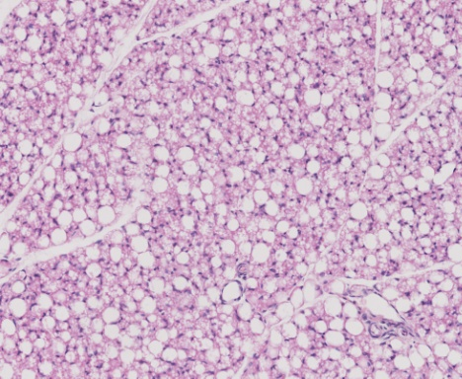
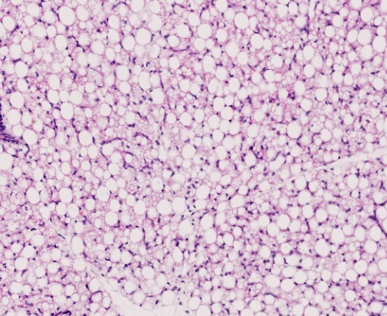
Figure 1.
(A) Treatment P<0.001
(C) Treatment P<0.05, GA P<0.001
100
100
+
*
*
UL
*
+
80
ML
80
60
60
PAT composition (%)
*
UL perimeter (µm)
40
*
40
20
20
0
0
Sham
Sham
TX
TX
(B) Treatment P<0.001 (UL only)
129 dGA
143 dGA
6
5
*
(D)
(E)
4
*
Relative PAT mass (g/kg)
3
2
1
0
100µm
100µm
Sham
TX
Sham
TX
129 dGA
143 dGA

Slide 2
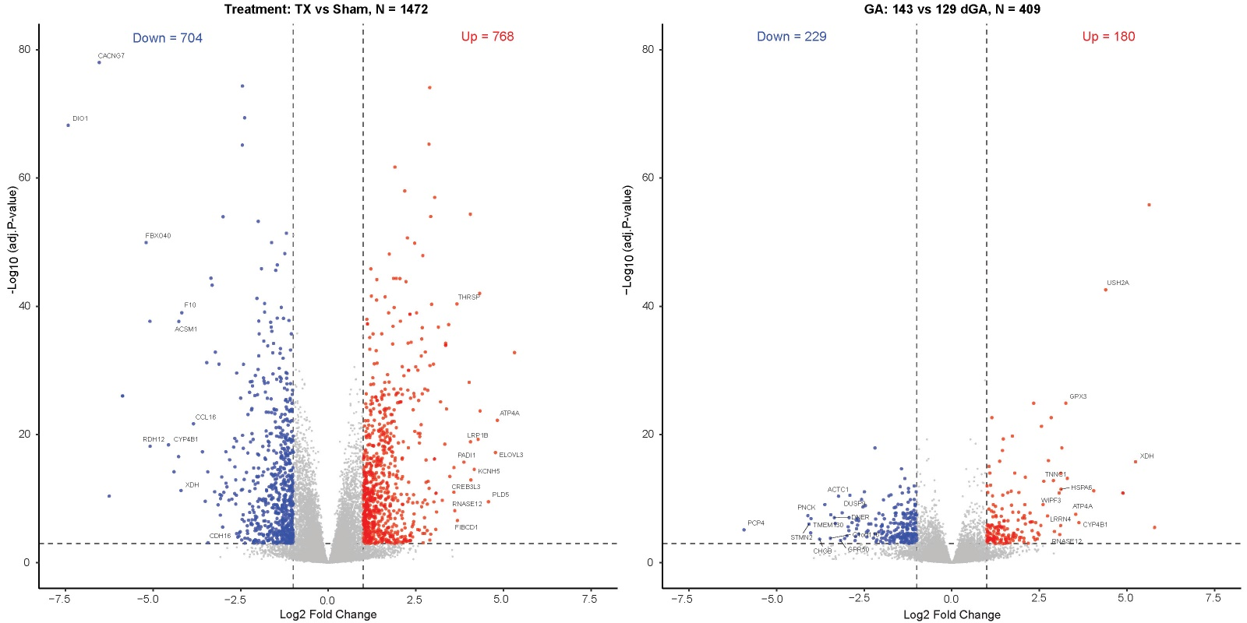
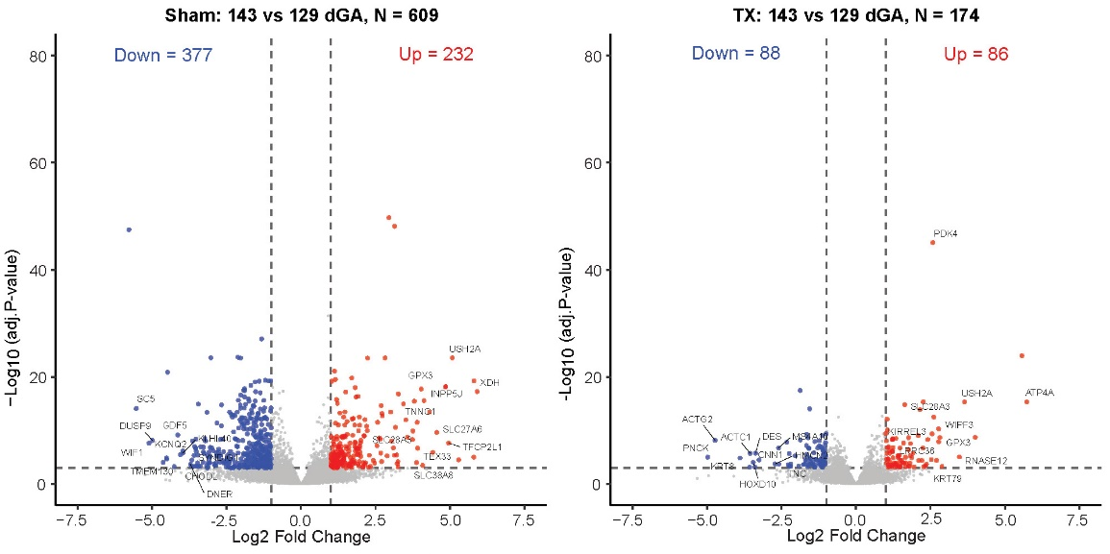
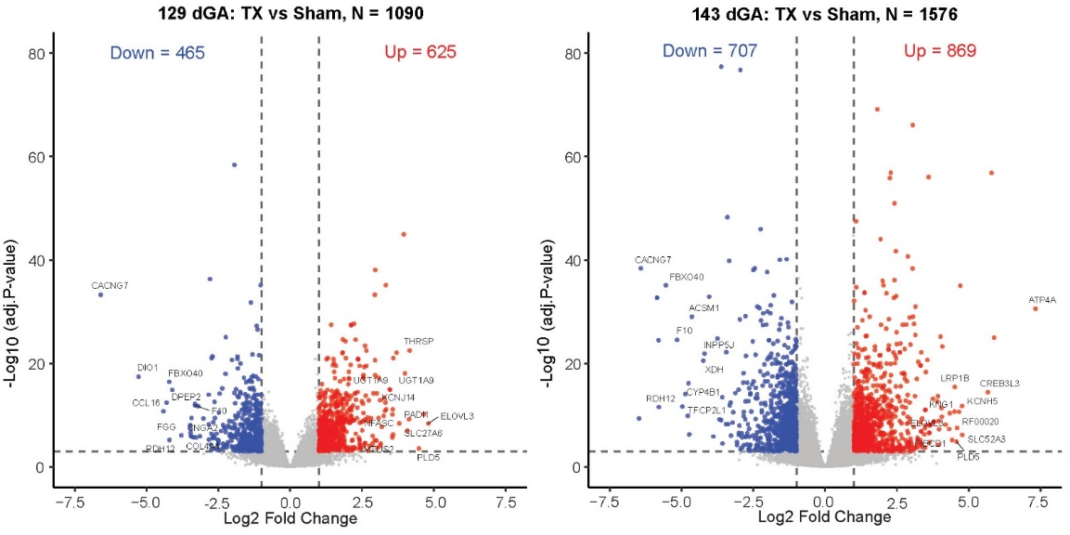
Figure 4.
(A)
(B)
Figure 2.
(C)
(D)
(E)
(F)

Slide 4
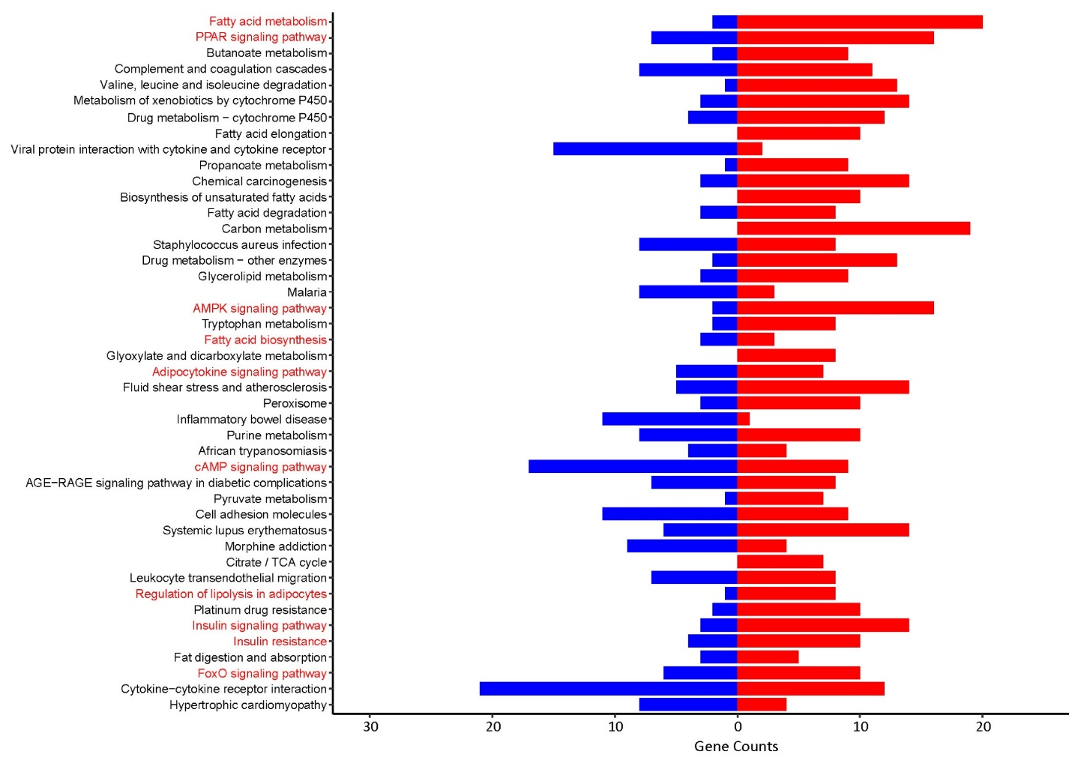
Figure 3.

Slide 5
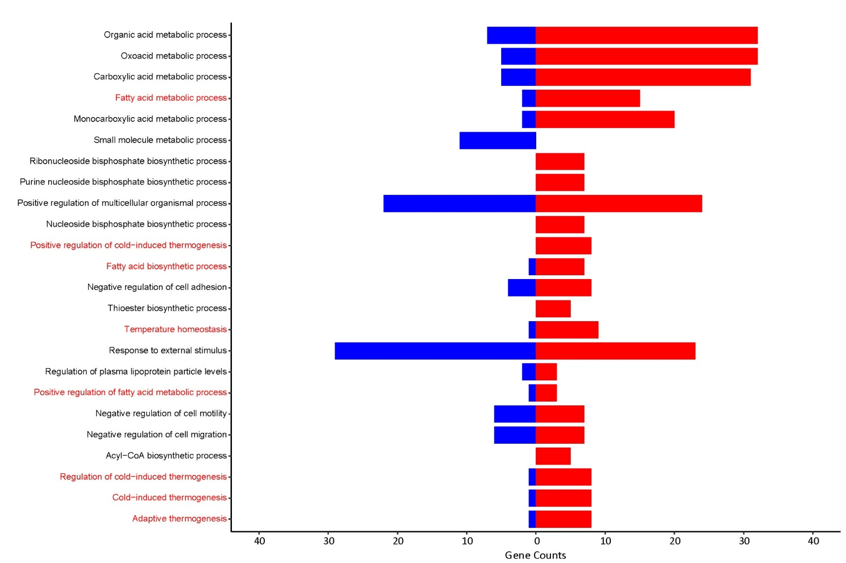
Figure 4.

Slide 8
(A) Treatment P<0.001, GA P<0.001, Interaction P<0.005
(B) Treatment P<0.001, GA P<0.001
(C) Treatment P<0.001
+
15
*
3
*
8
*
+
6
*
10
2
*
IGFI mRNA (AU)
IGFII mRNA (AU)
Leptin mRNA (AU)
4
5
1
+
2
0
0
0
(D) GA P<0.001
(E) Treatment P<0.05
(F) Treatment P<0.001
*
5
+
1.5
6
*
+
4
5
3
1.0
4
ADR α1A mRNA (AU)
ADR α1D mRNA (AU)
ADR α2A mRNA (AU)
*
3
2
0.5
2
1
1
0
0.0
0
(G) Treatment P<0.005, GA P<0.05
(H) Treatment P<0.001, GA P<0.001, Interaction P<0.01
(I) Treatment P<0.001
*
2.5
*
2.0
+
3.5
2.0
3.0
+
1.5
2.5
1.5
*
2.0
ADR β1 mRNA (AU)
ADR β2 mRNA (AU)
ADR β3 mRNA (AU)
1.0
1.5
1.0
0.5
0.5
1.0
0.5
0.0
Sham
TX
Sham
TX
0.0
Sham
TX
Sham
TX
0.0
Sham
TX
Sham
TX
129 dGA
143 dGA
129 dGA
143 dGA
129 dGA
143 dGA
Figure 6.

Slide 9
(A) Treatment P<0.001, GA P<0.05, Interaction P<0.05
(B) Treatment P<0.01, GA P<0.05
8
8
+
6
6
*
+
4
4
DIO1 mRNA (AU)
DIO2 mRNA (AU)
2
2
0
*
0
(C) Treatment P<0.005, GA P<0.05
(D) Treatment P<0.001, GA P<0.05
1.5
5
*
*
*
4
*
1.0
3
TRα mRNA (AU)
TRβ mRNA (AU)
+
0.5
2
1
0
0
Sham
TX
Sham
TX
Sham
TX
Sham
TX
129 dGA
143 dGA
129 dGA
143 dGA
Figure 7.

